Slide 1
LAPTOP REQUEST CATALOG ITEM
Team ID : LTVIP2025TMID60572
Team Size : 4
Team Leader : Kancharlapalli Jahnavi
Team member : Kothapalli Jayapal
Team member : Krishna Kishore
Team member : Lemuyel Raj

Slide 2
1. INTRODUCTION
1.1 PROJECT OVERVIEW
Laptop Request Catalog Item –
This project focuses on designing and implementing a Laptop Request Catalog Item within the ServiceNow platform. The goal is to create a centralized, automated solution that simplifies how employees request laptops, track approvals, and receive their devices without delays or confusion.
In traditional workflows, laptop requests are handled through manual emails and disconnected forms, leading to lost requests, slow approvals, and poor visibility. This project eliminates those bottlenecks by offering a digital, end-to-end process that improves efficiency, accountability, and user satisfaction.
1.2 Purpose
The purpose of this project is to simplify and modernize how employees request laptops in an organization. Instead of relying on outdated emails, slow approvals, and scattered tracking, this project creates a single, automated platform.

Slide 3
2. IDEATION PHASE
2.1 Problem Statements
Lack of transparency.
Manual, error-prone workflows.
Delayed approvals.
Poor tracking and accountability.
2.2 Brainstorming
Once the problems were clear, we brainstormed solutions:
Build a self-service portal where employees can request laptops easily.
Use dynamic forms to reduce confusion and mistakes.
Automate approval workflows so requests never get “stuck”.
Enable real-time tracking and notifications.
Integrate with asset management systems to keep inventory updated.

Slide 4
3. REQUIREMENT ANALYSIS
3.1 Customer Journey Map
The customer journey for the Laptop Request Catalog Item starts when an employee identifies the need for a laptop and accesses the online catalog. The employee fills out the request form and submits it for approval. The manager receives a notification and approves or rejects the request. If approved, IT staff process the request, check inventory, and prepare the laptop. The employee is notified about the status and receives the laptop. Finally, feedback is collected to improve the process. This journey ensures transparency, reduces delays, and provides a smooth experience for all users involved.
3.2 Solution Requirement
Dynamic request form with model, accessories, and priority selection.
Approval routing to managers with auto-escalation.
Real-time inventory validation.
Notifications at submission, approval, and delivery stages.
Dashboards for request tracking and reporting.
Secure login and role-based permissions.

Slide 5
3.3 Data Flow Diagram
Level 0 (Context Diagram):
Employee submits request
-> System -> Manager approval -> IT fulfillment ->Delivery confirmation.
Level 1:
Request Input: Employee → Request Form.
Approval Process: System → Manager.
Inventory Check: System ↔ Inventory Database.
Fulfillment: IT Staff → Update status.
Notifications: System → Employee/Manager.
3.4 Technology Stack
Frontend: HTML, CSS, JavaScript
Backend: Node.js
Database: MySQL
Notifications: SMTP Email, Twilio SMS
Authentication: LDAP/SSO
Hosting Platform: ServiceNow or Custom Web Server

Slide 6
4. PROJECT DESIGN
4.1 Problem Solution Fit
The solution addresses inefficiencies in the manual process by automating request submission, approvals, inventory checks, and fulfillment, ensuring faster and more accurate handling of laptop requests.
4.2 Proposed Solution
Develop a web-based catalog item where:
Employees can submit requests.
Managers can approve/reject with comments.
IT staff can fulfill requests based on inventory.
Notifications are automatically sent.
4.3 Solution Architecture
Presentation Layer: User interfaces for employees, managers, and IT staff.
Business Logic Layer: Request processing and workflow management.
Data Layer: Request records, inventory database.
Notification Module: Email/SMS services.
Authentication Module: Role-based access controls.

Slide 7
5. PROJECT PLANNING & SCHEDULING
5.1 Project Planning
Phases:
Requirement Gathering .
Design and Prototyping .
Development .
Testing .
Deployment .
Documentation .
6. FUNCTIONAL AND PERFORMANCE TESTING
6.1 Performance Testing
Test form submission response times.
Check concurrent request handling capacity.
Validate notification delivery speed.
Monitor inventory sync performance.

Slide 8
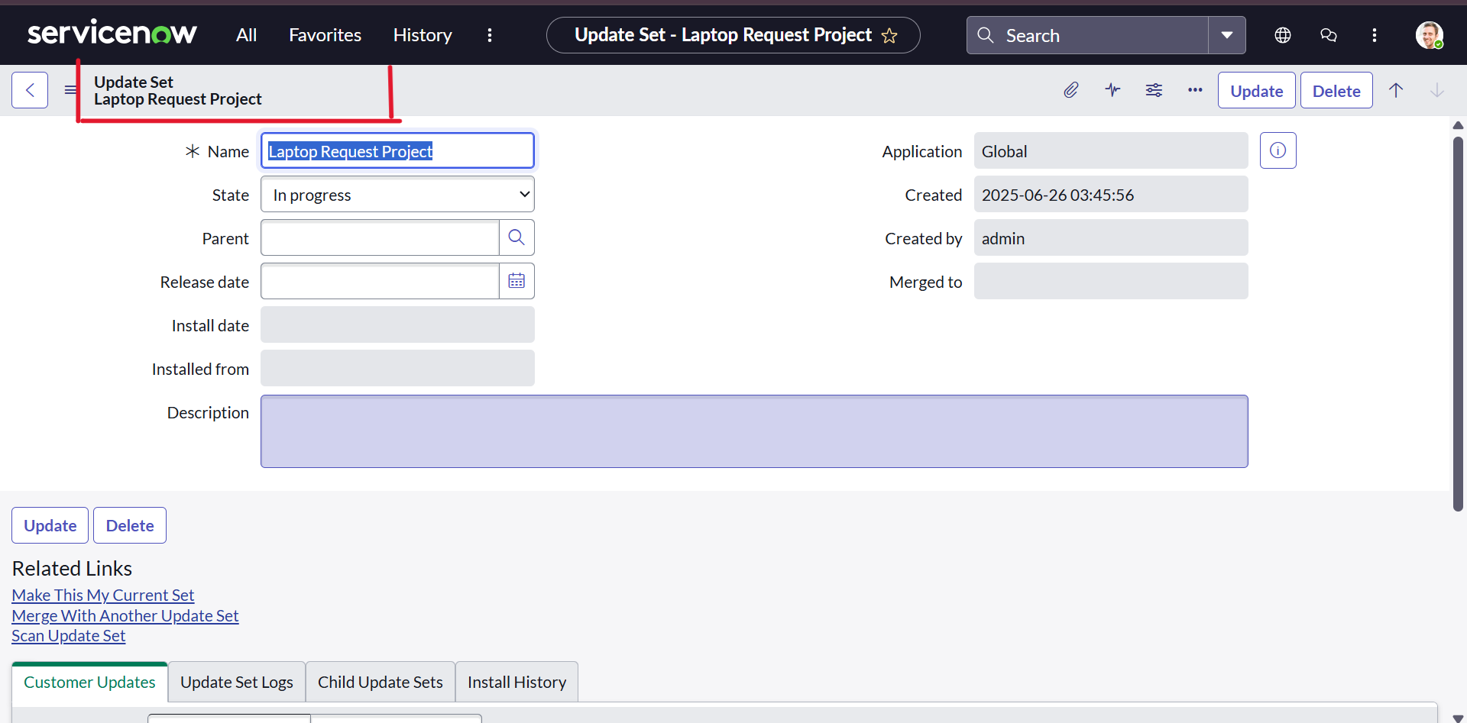
PROJECT
UPDATE SET:
Create Local Update set :-
To create a local update set, open ServiceNow and navigate to Local Update Sets under System Update Sets. Create a new update set named “Laptop Request”, submit it, and click Make Current to activate it. This ensures all configuration changes are tracked automatically for deployment and governance.

Slide 9
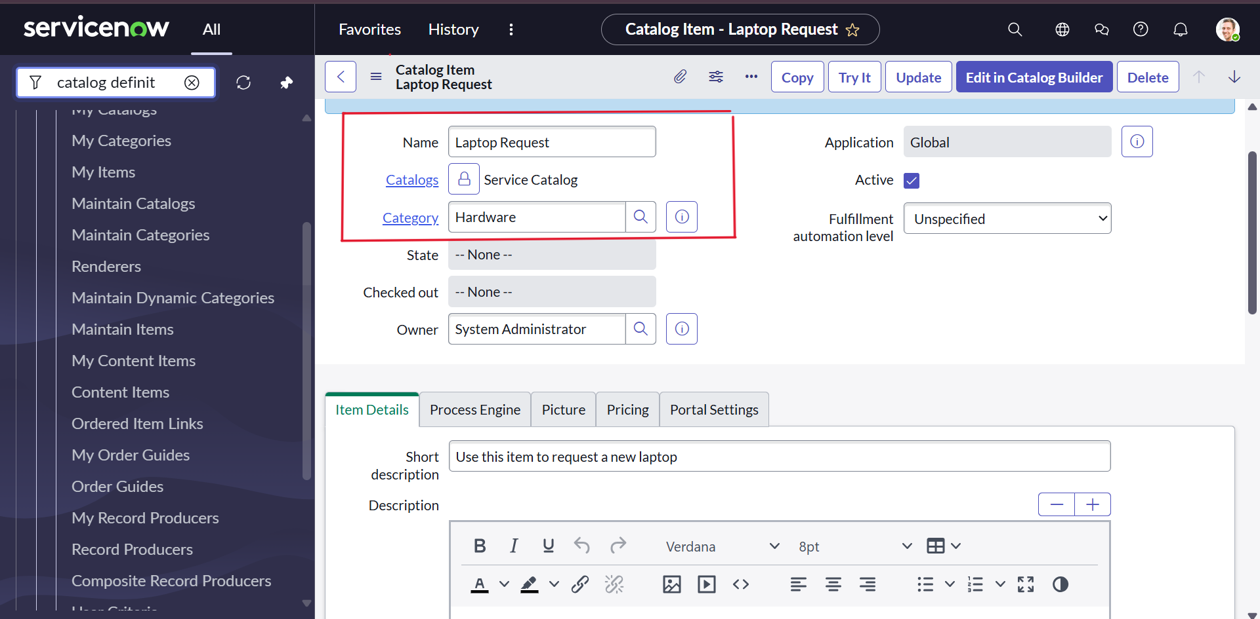
Service Catalog Item:
Create Service Catalog Item :-
In ServiceNow, open the Service Catalog and select Maintain Items under Catalog Definitions. Create a new catalog item with the following details:
• Name: Laptop Request
• Catalog: Service Catalog
• Category: Hardware
• Short Description: Use this item to request a new laptop
• Click Save to create the catalog item.

Slide 10
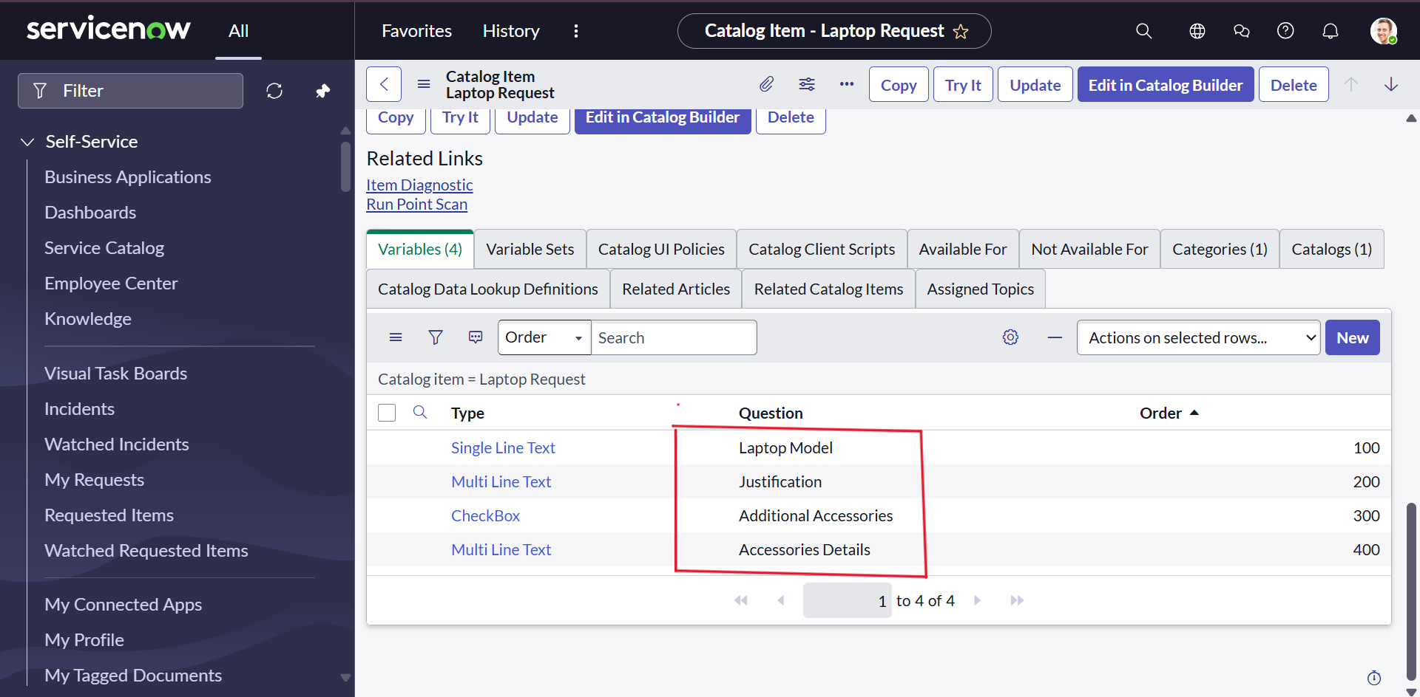
Service Catalog item:
Add Variables:-
After saving the catalog item, scroll to the Variables related list and create the following variables:
Laptop Model.
Justification.
Additional Accessories.
Accessories Details .
After adding these variables, save the catalog item form. If needed, click New again to add any remaining variables using the same process.

Slide 11
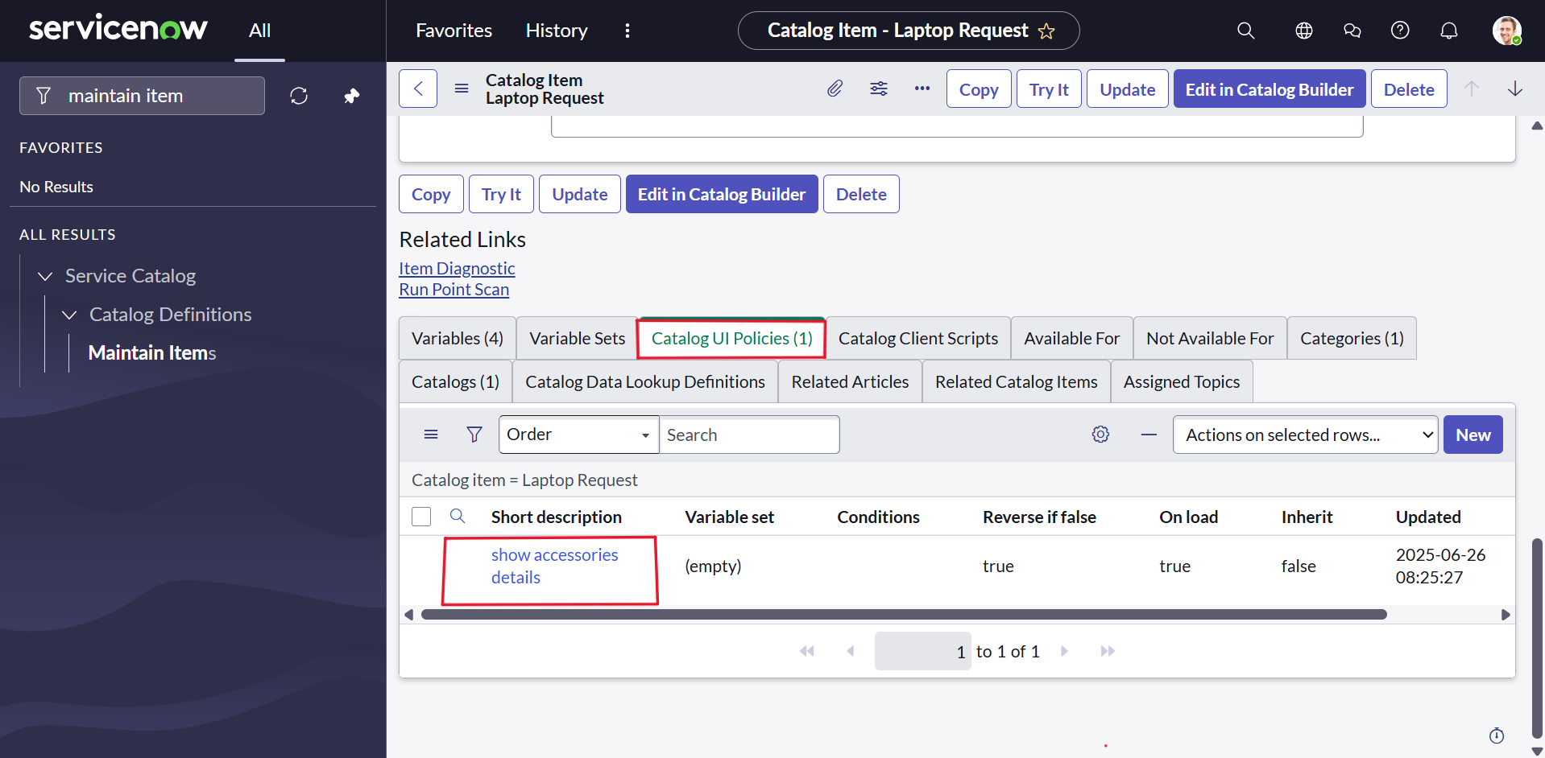
UI Policy :
Creating Catalog Ui policies:-
Open Service Catalog and select Maintain Items under Catalog Definitions. Search for the Laptop Request item created earlier and open it.Scroll to Catalog UI Policies and create a new policy with the short description Show Accessories Details. Click Save (do not submit).Next, in Catalog UI Policy Actions, create a new action:
Variable Name: accessories_details
Order: 100
Mandatory: True
Visible: True
Save the action, then save the Catalog UI Policy.

Slide 12
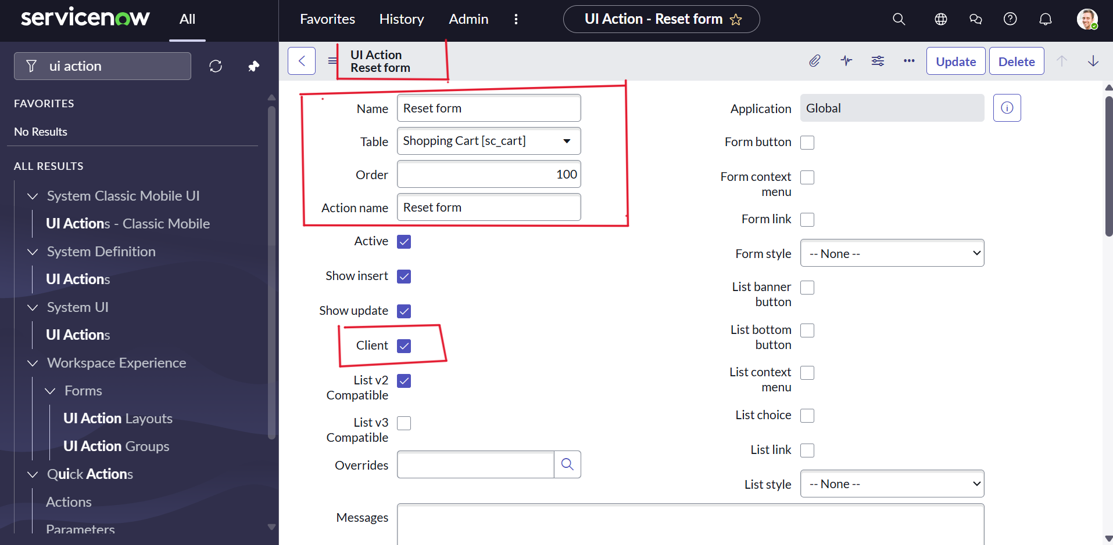
UI Action:
Create UI action:-
In ServiceNow, go to UI Actions under System Definition and create a new UI action with these details:
Table: shopping cart(sc_cart)
Order: 100
Action name: Reset form
Client : checked
Click Save to create the UI action.

Slide 13
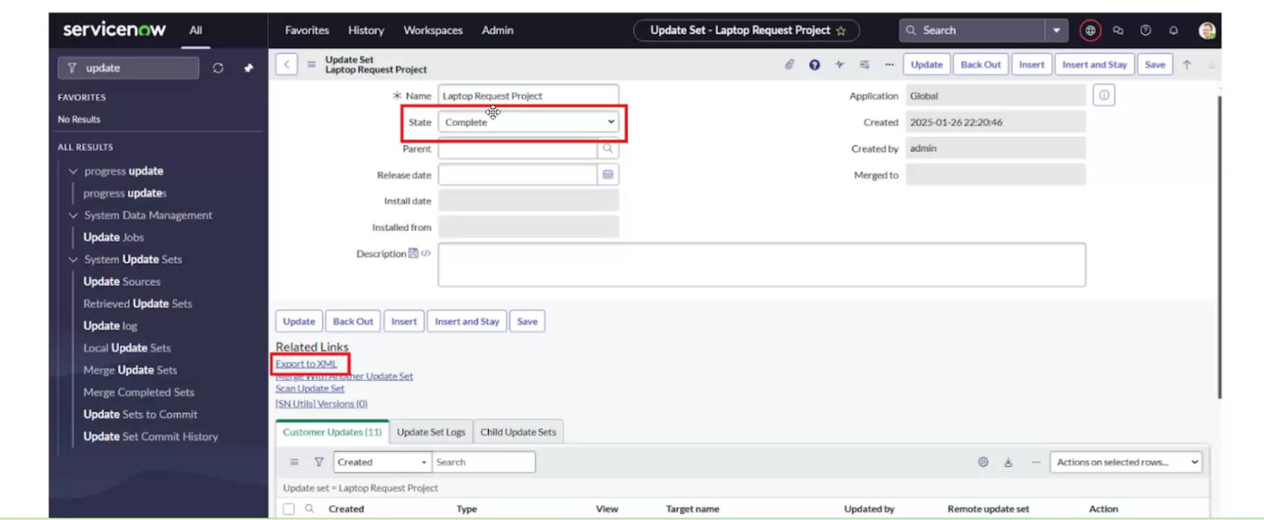
Export Update set:
Exporting changes to another instances:-
In ServiceNow, open Local Update Sets and select the created update set “Laptop Request Project.” Set the state to Complete.
In the Updates related list, you can view all captured changes. To export, click Export to XML—this downloads the update set file for deployment or backup.

Slide 14
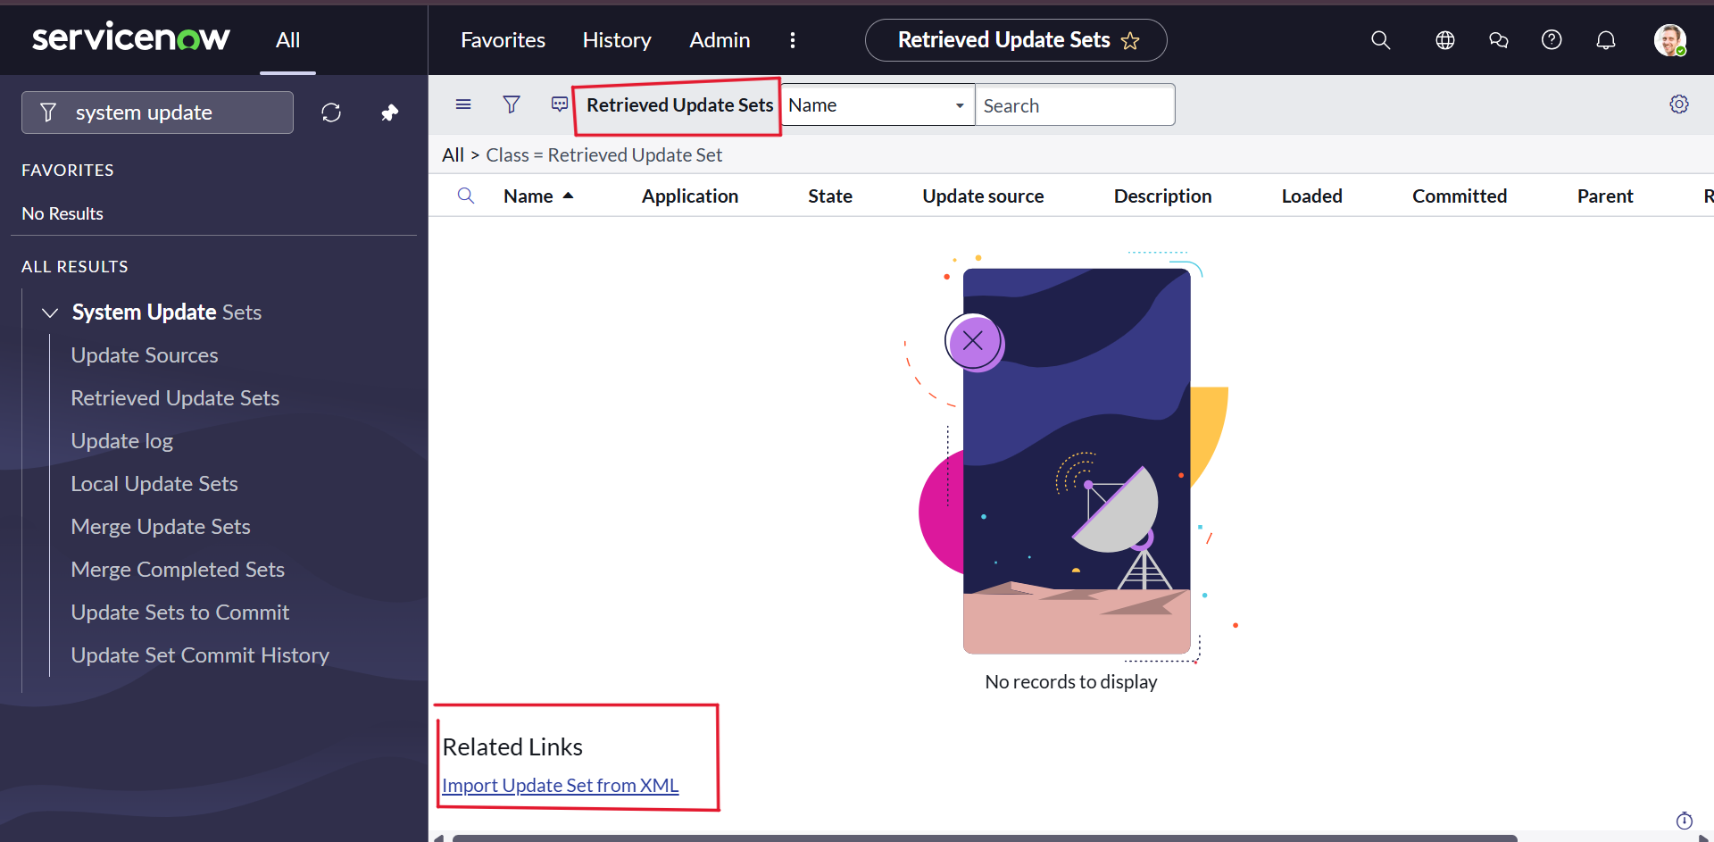
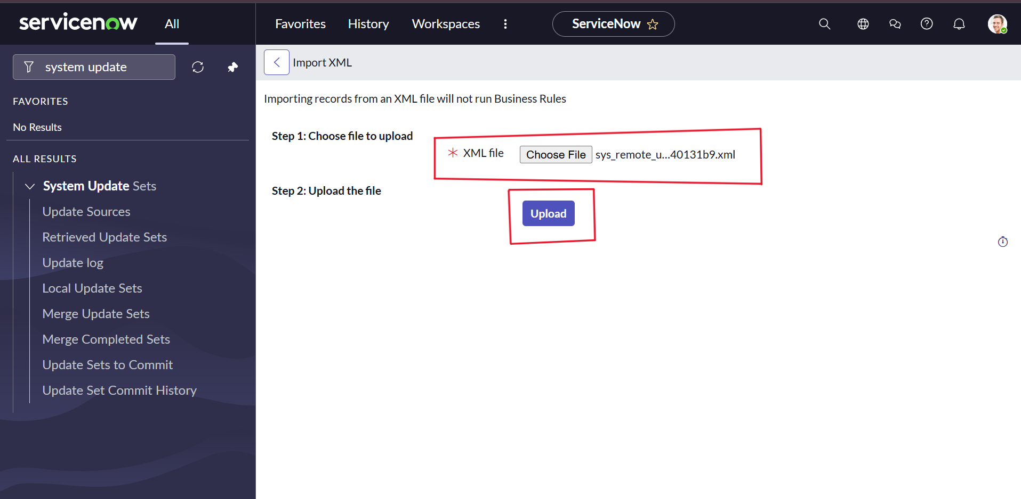
Login to another Instance :
Retrieving the update set:-
In another ServiceNow instance (opened in an incognito window), log in with your credentials.Navigate to Retrieved Update Sets under System Update Sets. Click Import Update Set from XML, upload the previously downloaded XML file, and click Upload to import it.
After committing the update set, all updates from the original instance are applied in this environment.

Slide 15
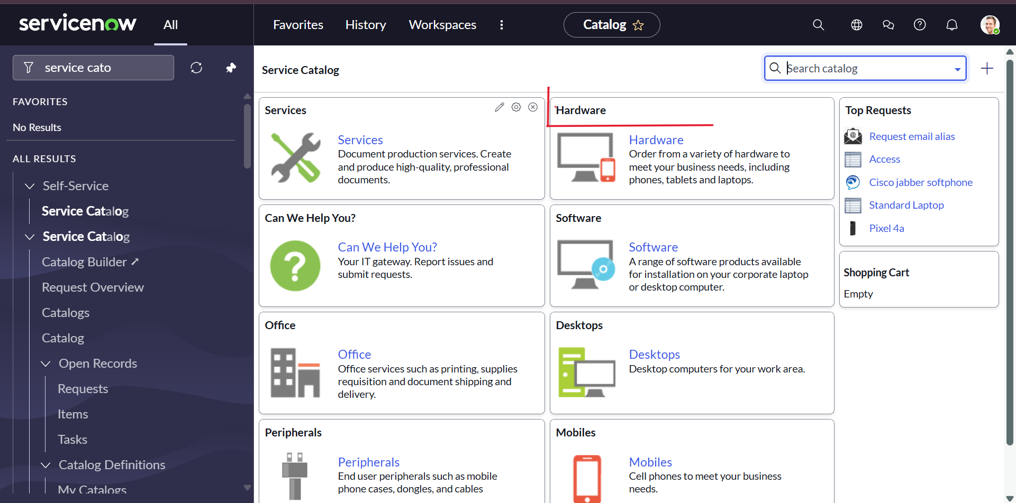
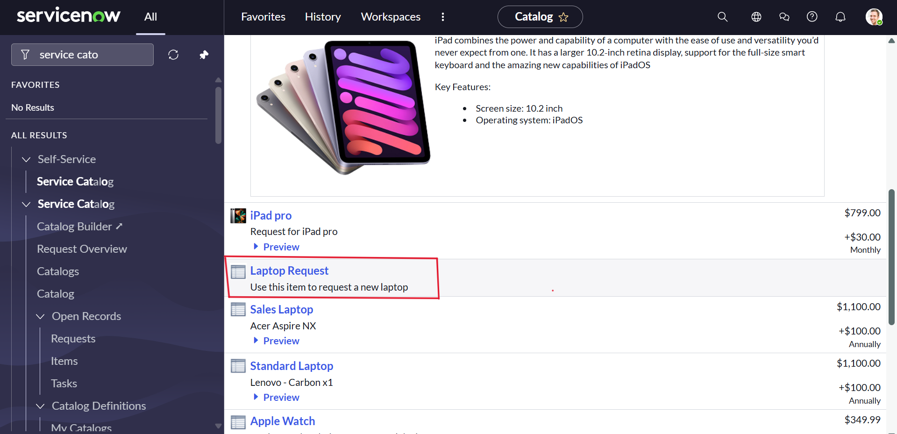
Testing :
Test Catalog Item:-
In the target ServiceNow instance, search for Service Catalog in the application navigator and open Catalog under Service Catalog.
Select the Hardware category and search for the Laptop Request item. Open the item to verify the configuration—it shows three variables by default.

Slide 16
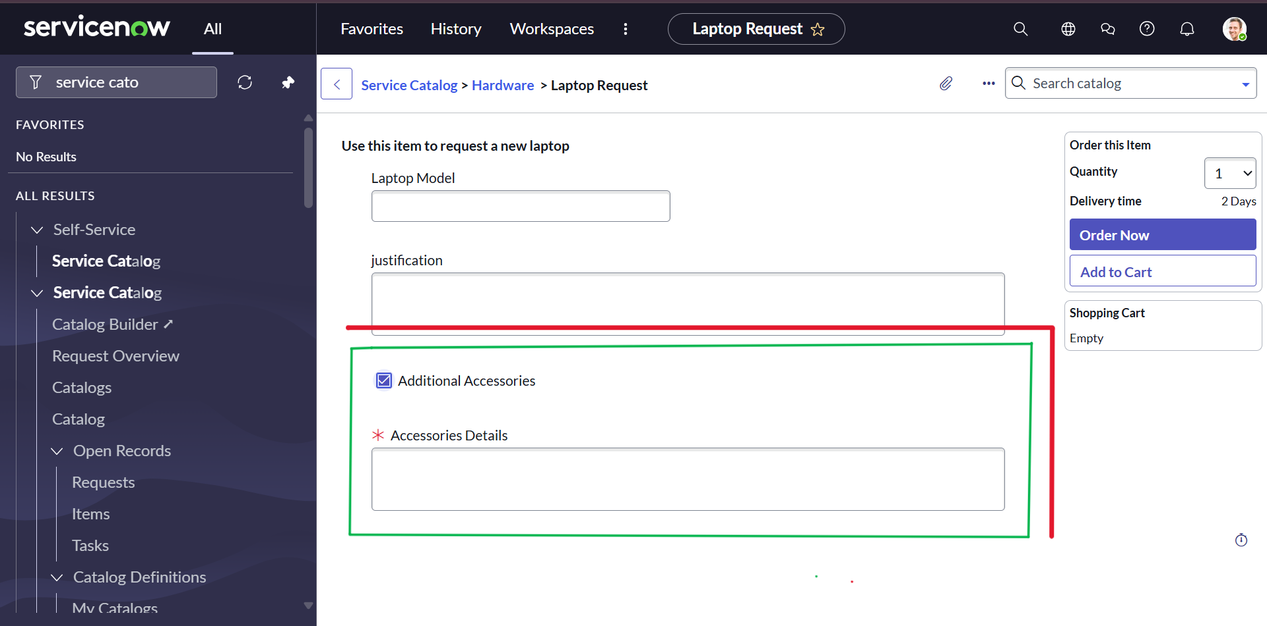
7. RESULTS
When the Additional Accessories checkbox is selected, the Accessories Details field becomes visible and mandatory, confirming that the setup works as intended.
7.1 Output Screenshots

Slide 17
8. ADVANTAGES & DISADVANTAGES
Advantages:
Reduces manual errors.
Improves processing speed.
Enhances transparency and tracking.
Ensures accurate inventory management.
Disadvantages:
Initial setup and training required.
Dependency on network availability.
Limited usability for non-technical staff without training.
9. FUTURE SCOPE
Integration with mobile apps.
AI chatbot support for request submission.
Predictive inventory recommendations.
Enhanced analytics and SLA monitoring.

Slide 18
10. CONCLUSION
The Laptop Request Catalog Item project successfully automates the laptop request process, minimizing delays and improving user satisfaction. It provides a structured and transparent system that benefits employees, managers, and IT staff alike.
11. APPENDIX
GitHub & Project Demo Link:
GitHub Repository Link:-
https://github.com/JahnaviKancharlapalli/laptop-request-catalog-item
Live Project Demo Link:-
https://drive.google.com/file/d/1Kpw94_05YIU32tNJaZeFRiy7CmxrjYVz/view?usp=drive_link

